Slide 1


Predicting Restaurant Revenue
Brian Mann
David Berberena

Slide 2
Background
Roughly sixty percent of new restaurants close their doors within the first three years of operation
Many factors must be considered when opening a restaurant
Exploring customer analytics raises the chance of success
Notes:
Running a restaurant is not for the faint of heart
Factors: Construction, hiring, maintenance, food distribution, etc.
Once built, how can you ensure success?

Slide 3
The Problem
Restaurant conglomerate portfolios consist of multiple brands and concepts
These companies are interested in better predicting the revenue generated from these restaurant factors to maximize their bottom line
Machine learning models can offer an analytical look into revenue factor identification and prioritization
Notes:
E.g. Yum! Brands, Bloomin’ Brands, Darden Restaurants
Restaurants have been running promotions and marketing
Customer analytics and business practices for each restaurant

Slide 4
The Data
Variable Name | Description
Number_of_Customers | Average # of hourly customers
Menu_Price | Average entrée price
Marketing_Spend | Money spent on marketing (in $1,000s)
Cuisine_Type | Culture the menu is influenced by (Italian, Japanese, etc.)
Average_Customer_Spending | Average bill per customer
Promotions | Boolean value of whether a promotion was implemented
Reviews | Number of reviews
Monthly_Revenue | Total monthly revenue (in $1,000s)
Notes:
Data comes from simulated dataset on Kaggle
1,000 restaurants; 8 variables
Italian, Japanese, Mexican, American
Monthly Revenue = Target

Slide 5
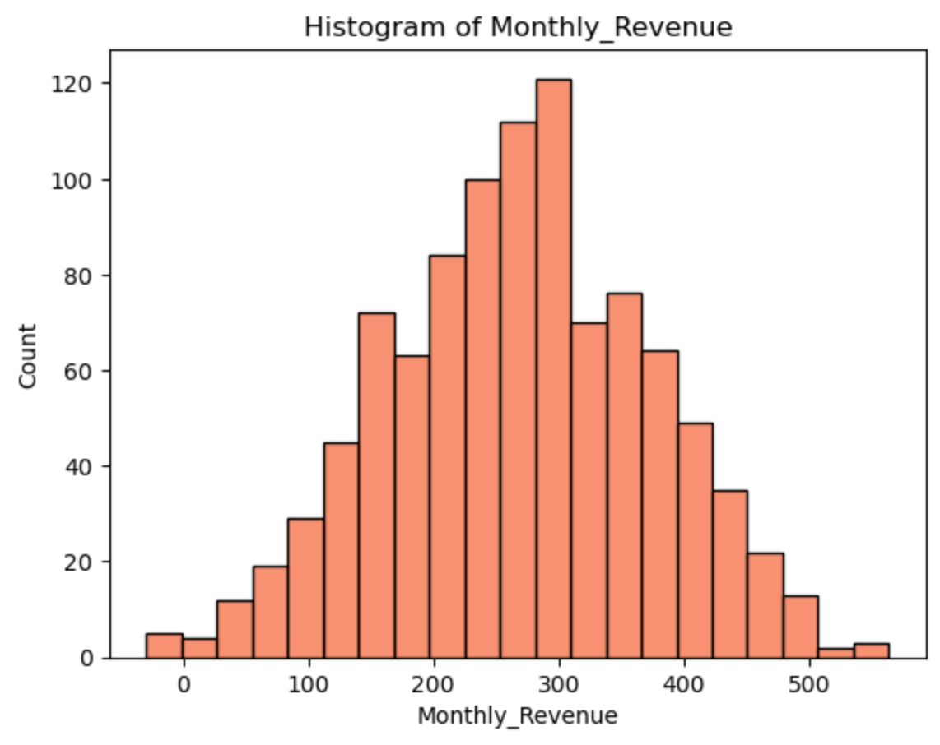
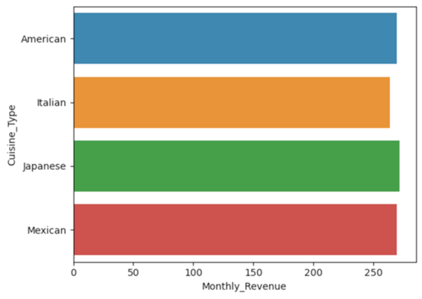
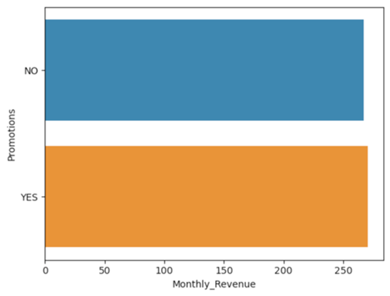
Bar Chart/Histogram EDA
Notes:
Monthly revenue = Normally distributed
Other variables = Uniformly distributed

Slide 6
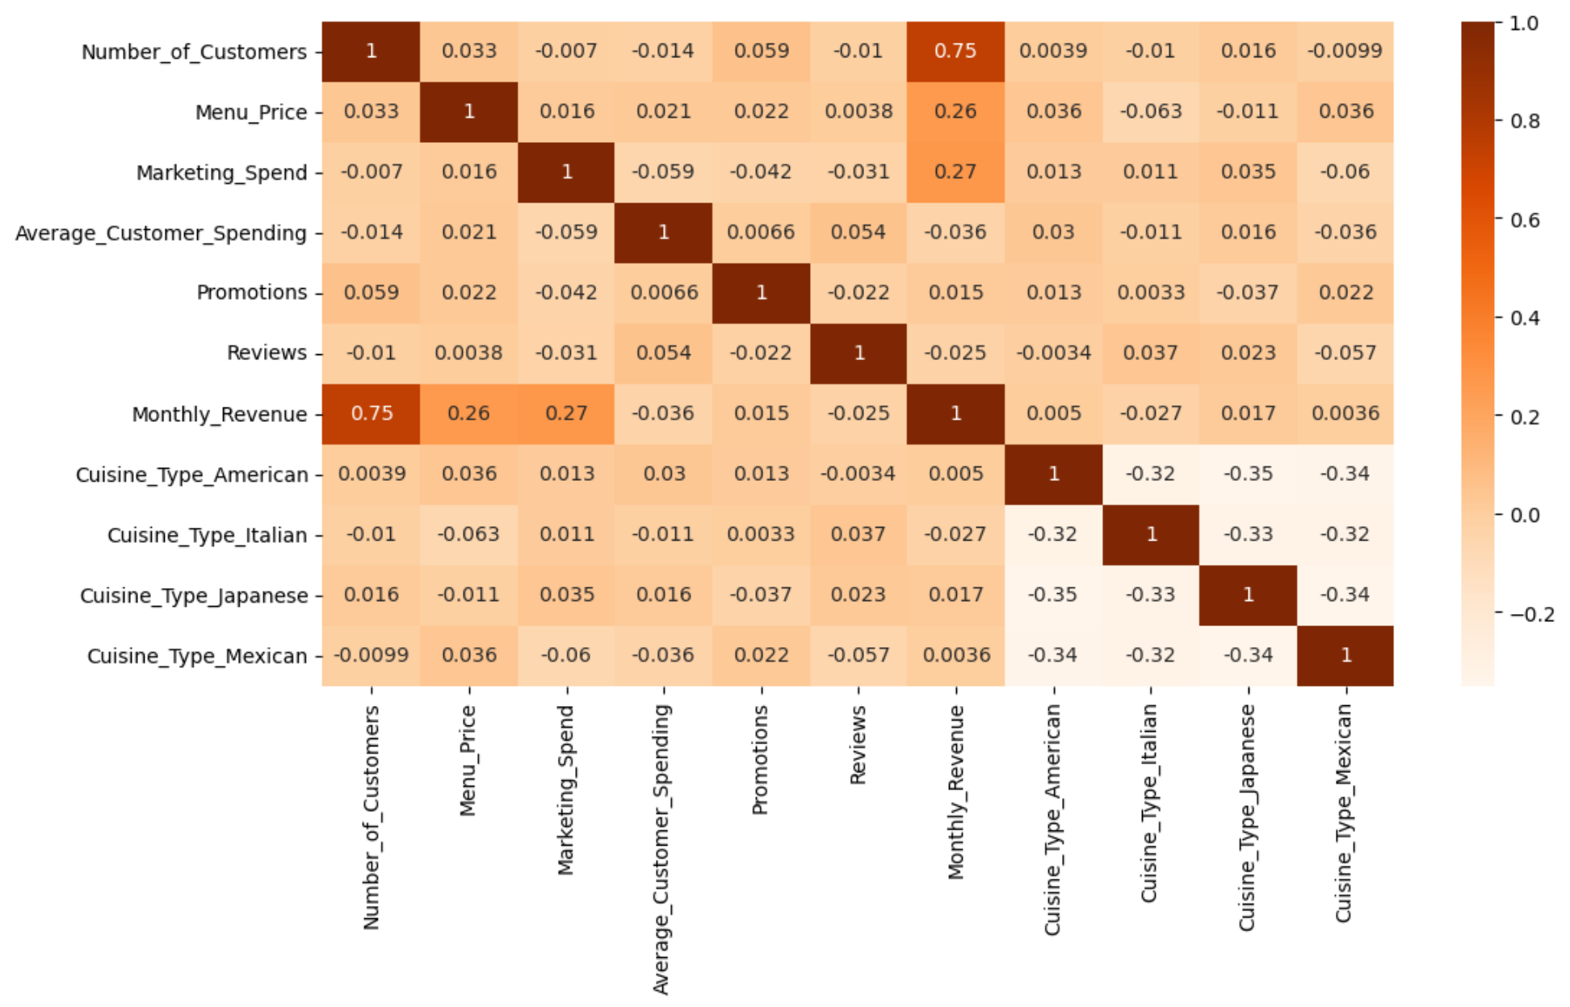
Correlation EDA
Notes:
- Monthly revenue only major correlations with number of customers, menu price and marketing expenditure

Slide 7
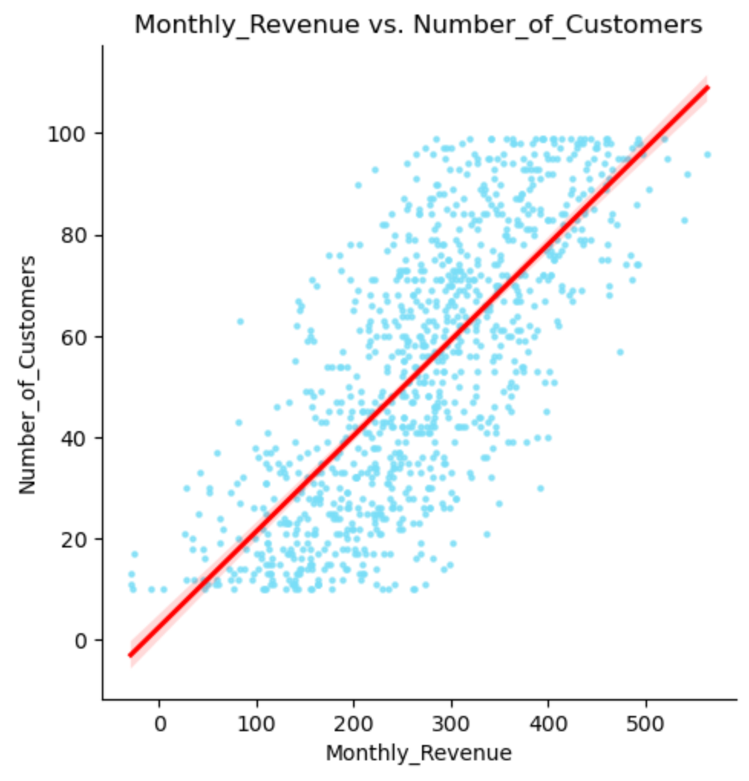
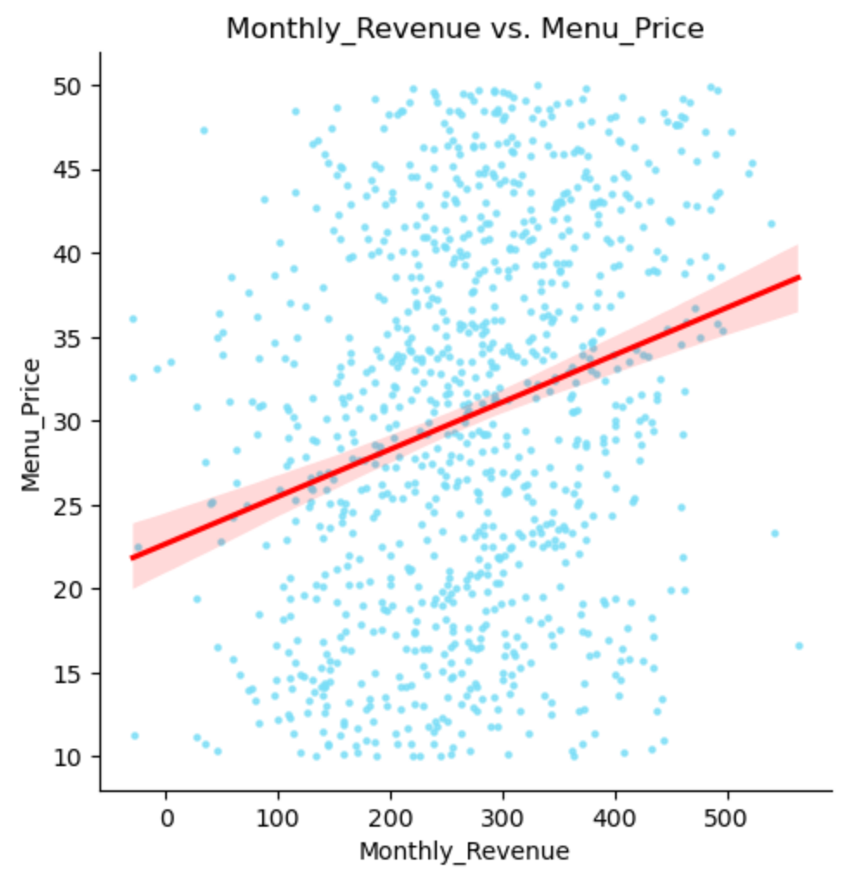
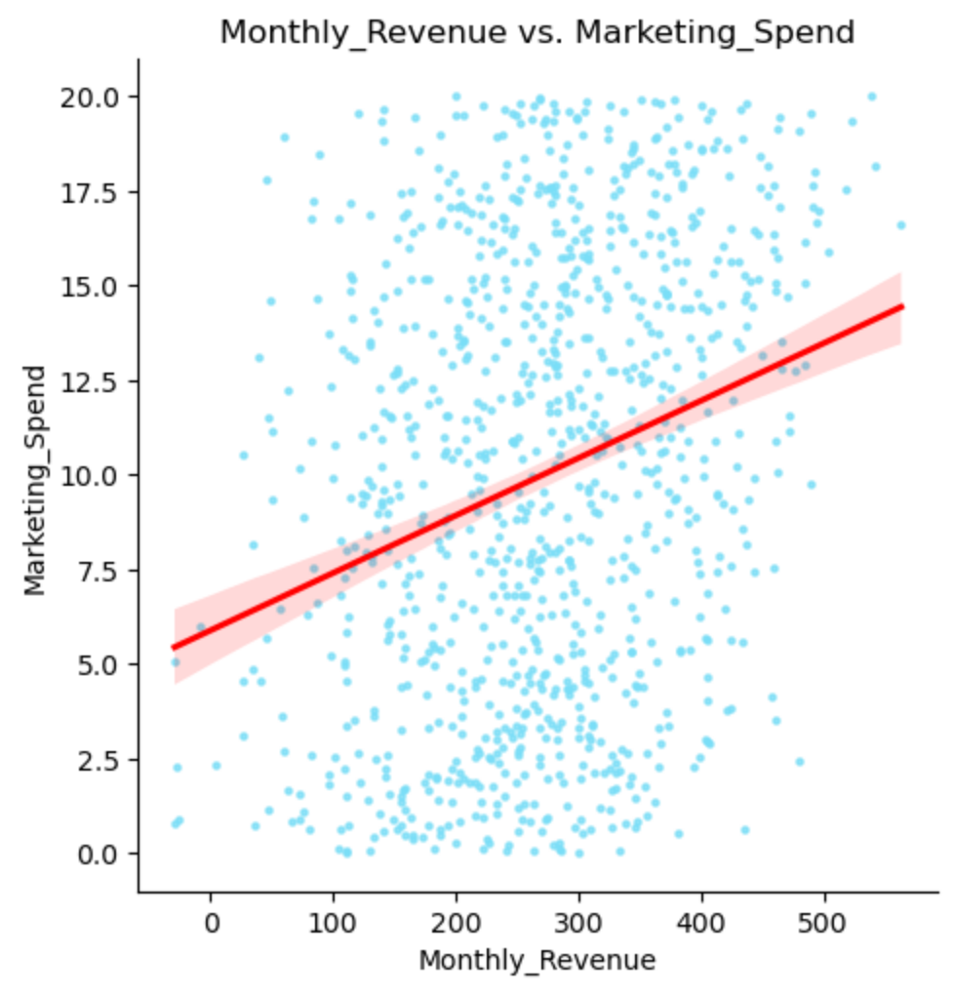
Scatterplot EDA of Correlated Variables
Notes:
First plot has a clear trend line with minimal error
Other plots the trend is less pronounced, higher margin of error

Slide 8

Data Preparation
Categorical features were converted to numerical features
The data was split into training and testing datasets using an 80/20 ratio
Model tuning techniques were established for model generation, such as grid search cross-validation

Slide 9
Modeling
Model 1: Ordinary Least Squares linear regression model with Ridge regression normalization
Model 2: Decision Tree model
Model 3: Ensemble model using Ridge regression, Decision Tree, Random Forest, and Gradient Boosting

Slide 10
Results
Model | RMSE | R²
OLS Model with Ridge Normalization | 60.856 | 0.693
Decision Tree Model | 77.338 | 0.505
Ensemble Model | 61.785 | 0.684

Slide 11
Feature Importance
Variable Name | Relative Importance
Number_of_Customers | 74.59
Menu_Price | 24.54
Marketing_Spend | 26.00
Average_Customer_Spending | -0.56
Promotions | -3.58
Reviews | -1.36
Cuisine_Type_Italian | 0.45
Cuisine_Type_Japanese | -0.68
Cuisine_Type_Mexican | 0.23

Slide 12
Conclusions
Our initial model choice of OLS with Ridge normalization performed the best with an RMSE of 60.8 and R² of 0.69
Although this model accounts for roughly 70% of the variance, the RMSE is still somewhat high (~$60,000 monthly margin of error)
As it stands, this model is not quite ready for deployment

Slide 13
Future Recommendations
Further investigation is warranted as to why marketing expenditure had a positive impact on revenue, while promotions did not
Customer surveys, demographics, seasonal trends, and competition should be factored into future data collection
With more data, a more viable model can be created

Slide 14
Sources
Letchinger, C. (2013). The Anatomy of Restaurant Failure: Dead Man Walking. Menu Cover Depot. https://www.menucoverdepot.com/resource-center/articles/restaurant-failure/
Abdurakhimov, M. (2024). Restaurants Revenue Prediction [Data set]. Kaggle. https://doi.org/10.34740/KAGGLE/DSV/7420974
Ozer, E., O'Connell, M., Kan, W. (2015). Restaurant Revenue Prediction. Kaggle. https://kaggle.com/competitions/restaurant-revenue-prediction
Smilansky, V. (2023). Data-driven decision making: How to use data to make more informed decisions. ThoughtSpot. https://www.thoughtspot.com/data-trends/best-practices/data-driven-decision-making
Chugh, A. (2020). MAE, MSE, RMSE, Coefficient of Determination, Adjusted R Squared — Which Metric is Better?. Medium. https://medium.com/analytics-vidhya/mae-mse-rmse-coefficient-of-determination-adjusted-r-squared-which-metric-is-better-cd0326a5697e
Lindgren, I. (2019). The Dangers of Under-fitting and Over-fitting. Medium.
https://medium.com/analytics-vidhya/the-dangers-of-under-fitting-and-over-fitting-495f9efa1847

